Slide 1
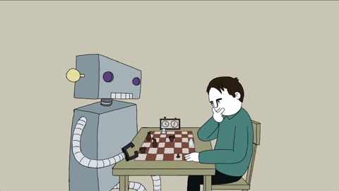
CSE4037
REINFORCEMENT LEARNING
HIERARCHICAL ABSTRACT MACHINES

Slide 2
Module No. 6
Hierarchical Reinforcement Learning
8 Hours
Hierarchical Reinforcement Learning
Types of Optimality
Semi MDP Model
Options
Learning with Options
Hierarchical Abstract Machines
A partially observable Markov decision process.

Slide 3
Hierarchies of Abstract Machines — A forgotten Hierarchical RL Framework
Few frameworks come close to the Hierarchies of Abstract Machines (HAMs) framework in elegance and power of expression.
HAMs model hierarchies naturally by assuming there are machines making calls to each other. Each machine has learnt a policy to solve some sub-problem in the environment and the upshot is that they can be “transferred” to other domains easily.

Slide 4
Why are hierarchies important?
Though there are several answers out there, a simple example to exemplify is to notice that humans try to generalize problem solving by transferring solutions.
For example, if you want to learn how to open the door, you don’t necessarily learn “walking” when you are solving that problem. You have probably already learnt how to walk, you have stored that solution somewhere, and you just “use” it. In this case, the hierarchy could be something like “Walk to the Door -> Turn the knob”.
When you are solving a problem, open the window, you just use the hierarchy “Walk to the window -> Push the windows”. The walking part is used multiple times and it is thus useful to store it as a solution in itself.
There are lots of commentaries about why Hierarchies are important. Exploration and generalizations are the two main uses.

Slide 5
Famous frameworks
MAXQ and Options are two other frameworks which are widely used.

Slide 6
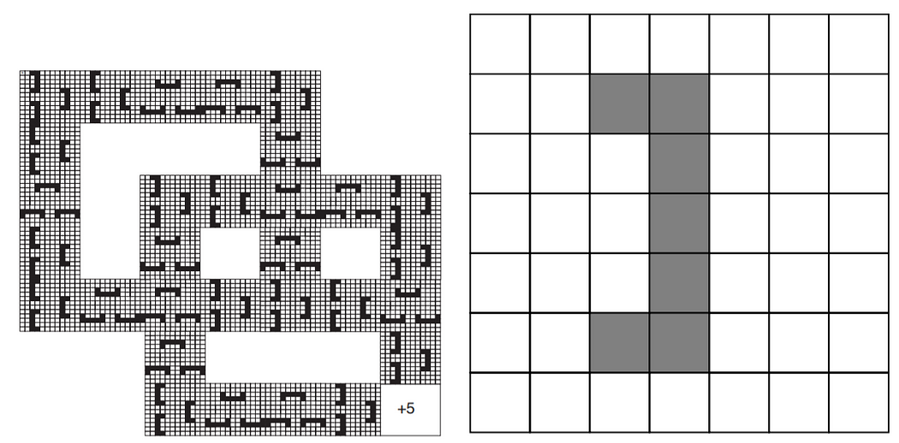
Example Domain
The gridworld is on the left and the picture on the right is a magnified obstacle, which is concave.
The peculiar shape of the obstacle is to increase the hardness of the problem. If not for the concave shape, the agent (the robot which is trying to solve the problem) can just walk along the walls and get to the other side with ease. In this case the agent might find it beneficial to back-off and go another direction.

Slide 7
Hierarchy of machines and machine states
It is crucial to understand what machine states are, to construe the learning algorithm. There are four machine states:
Action states execute an action in the environment
Call states execute another machine as a subroutine
Choice states non-deterministically select a next machine state
Stop states halt execution of the machine and return control to the previous call state
The state space of the problem is H X S, where H is the machine state and S is the state of the underlying MDP. The actions are executed as usual, adhering to a policy defined on the states.

Slide 8
Hierarchy of machines and machine states
When a machine comes across a call state, it deterministically executes the machine is it supposed to. Stop states just return the control back to the parent machine.
The reader may be puzzled about where the learning is happening. The only states where learning is happening is in the choice state, where the agent learns which machine to call next or which action to take.
Unlike the case where the learning was directly going to happen on the MDP, where the actions are learnt in every state, in the HAM framework, learning only happens in choice states. Thus, the state space over which the learning is happening could be smaller than actual state space. The following example will make the description clearer.

Slide 9
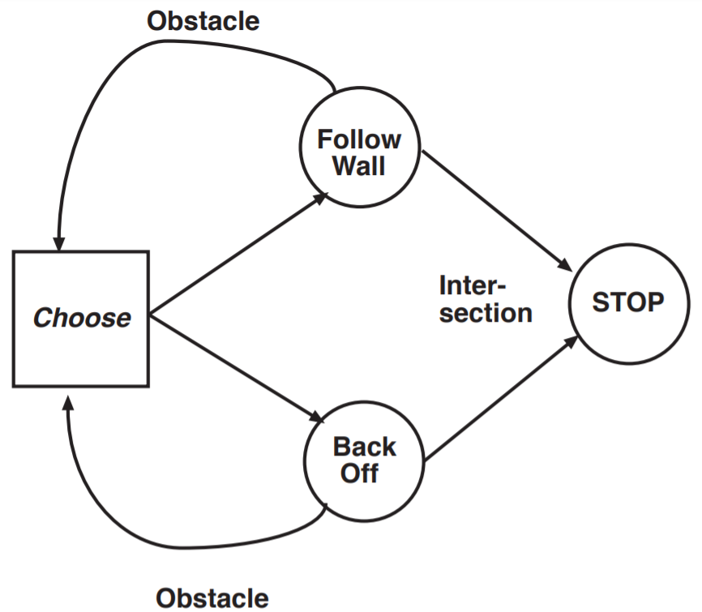

Slide 10
Hierarchy of machines and machine states
If this hierarchy was used to solve the MDP, whenever an obstacle would be encountered, the agent enters a choice state where it either chooses the follow-wall machine, which just continually follows the wall in some direction, or it chooses the back-off machine, which backs-off and the continues execution. So the agent has to decide which machine to call and with what probability, and that would comprise the machine’s policy! So the learning will happen only in this choice state.
The Q-Learning formulation is fairly straight-forward, but the point of this write-up was to show how background knowledge can be easily encorporated in this framework. If one is sure of a part of the policy, they could specify the functioning of a whole machine. If one is unsure about the execution of Machine A vs. Machine B, they could just create a choice state and let the agent learn for itself!

